Slide 1
run the experiment of TGN normally and observe how the memory vectors change as the training progress
compute the statistic of the memory vector (mean, and variance, standard deviation)
feed the memory vectors to T-SNE
read and explore the ’Towards Better Evaluation for Dynamic Link Prediction’

Slide 2
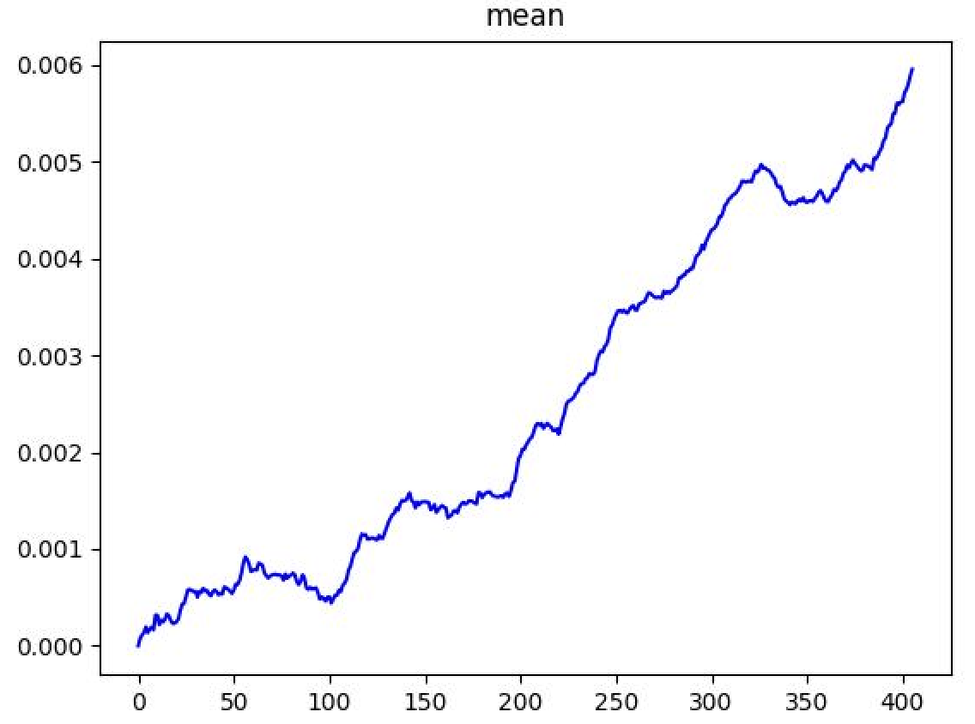
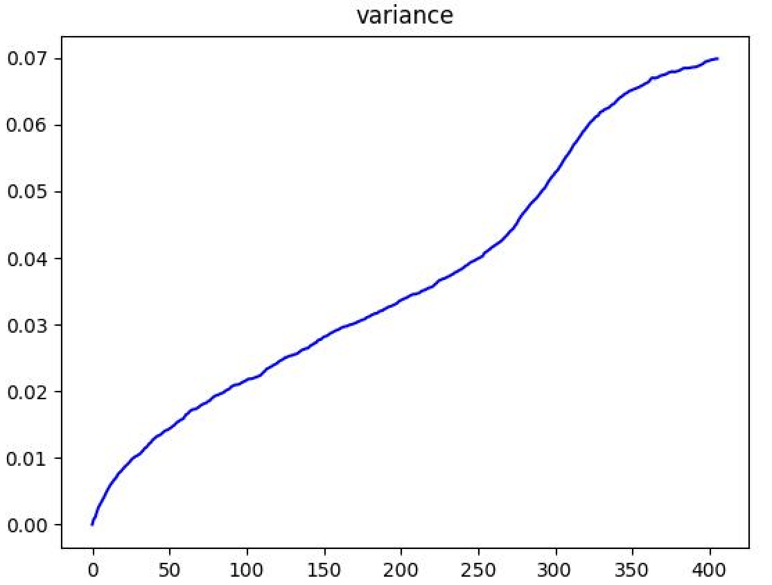
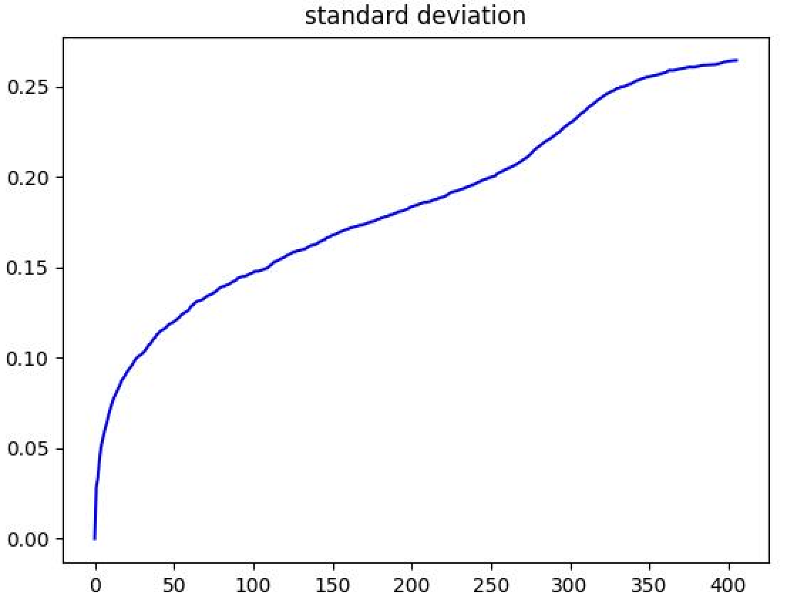
Statics of the memory vector

Slide 3
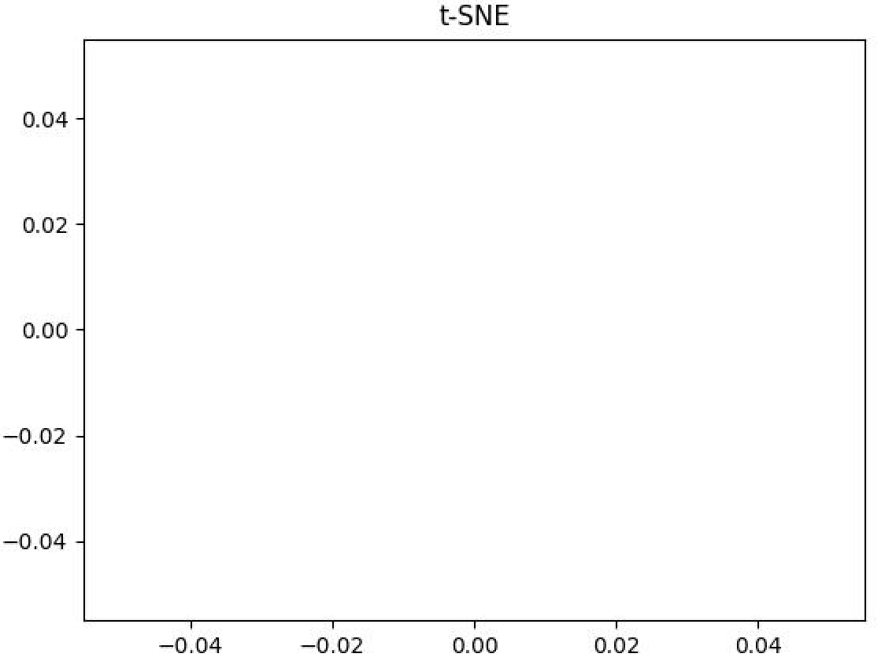
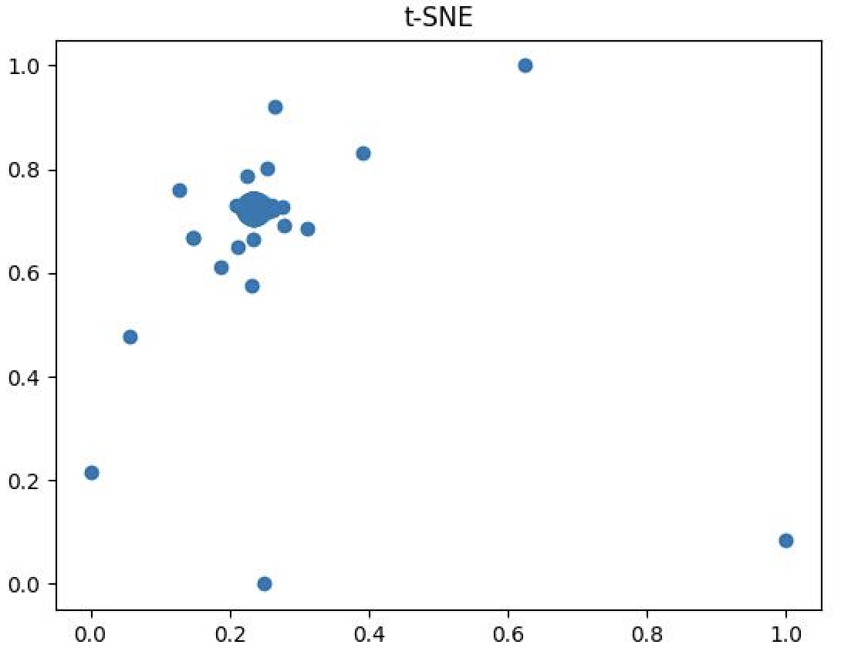
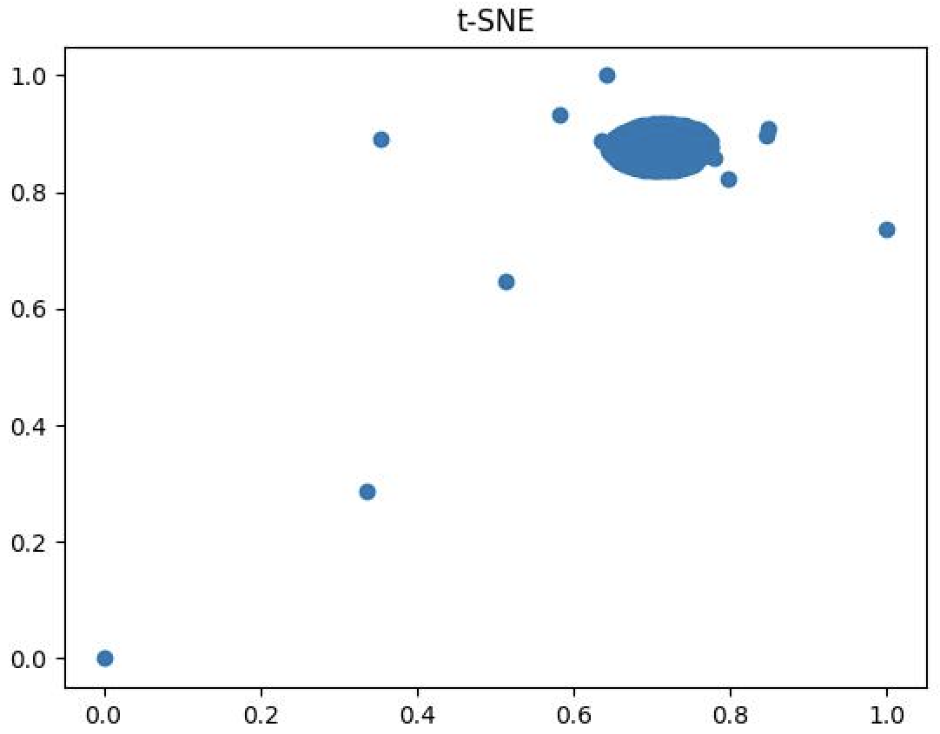
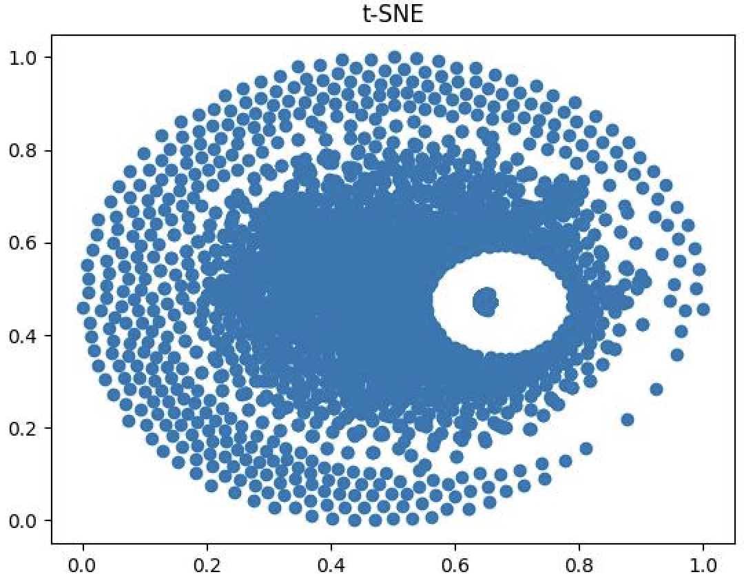
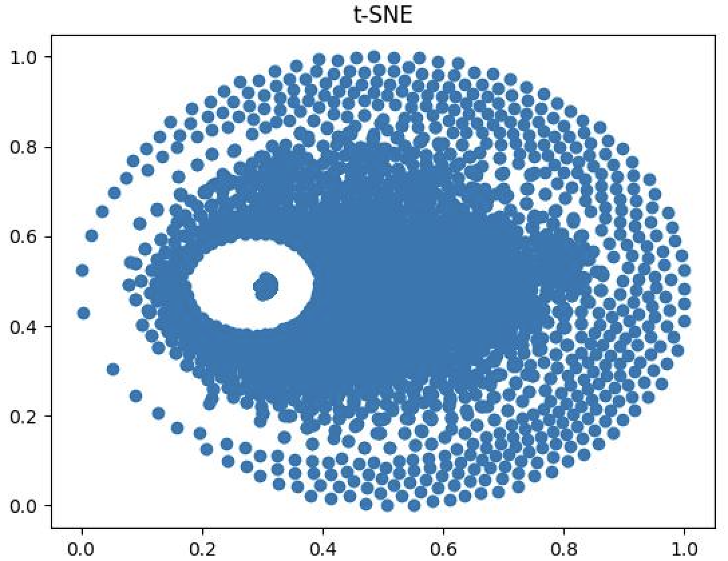
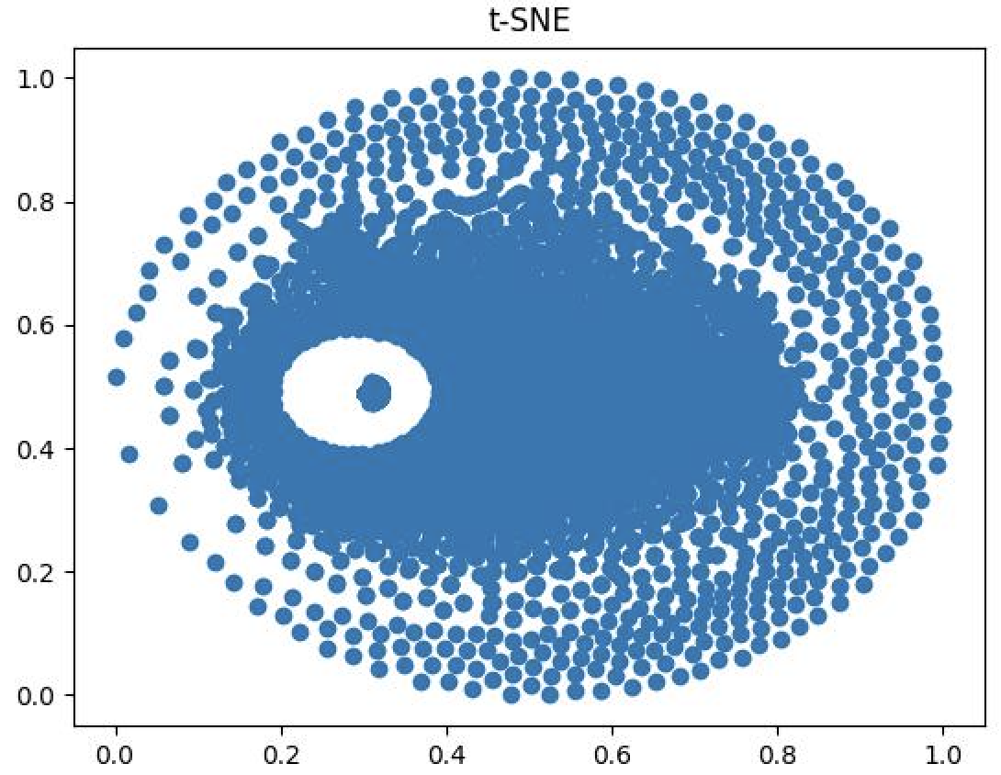
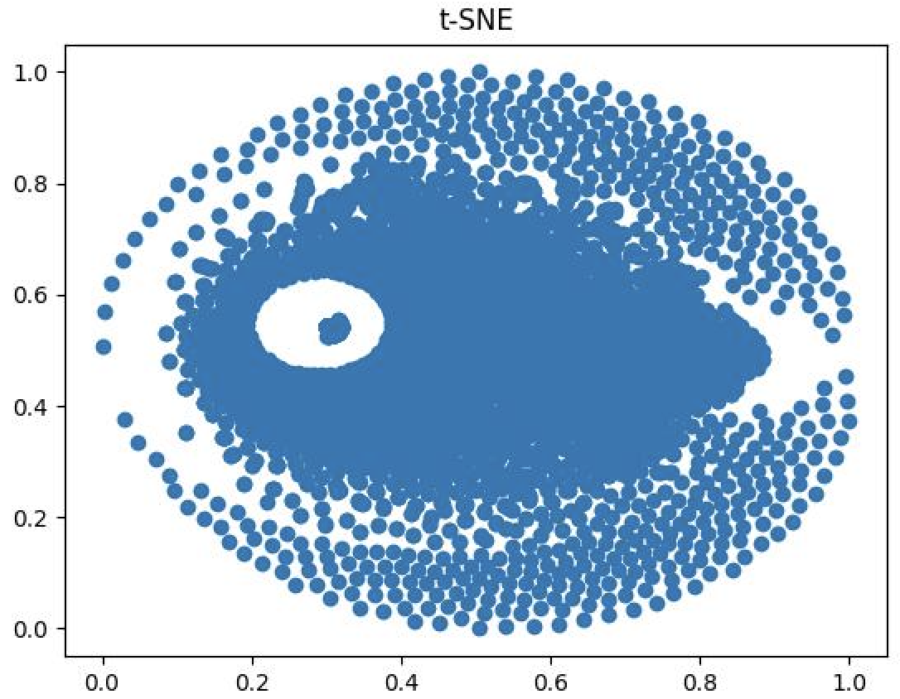
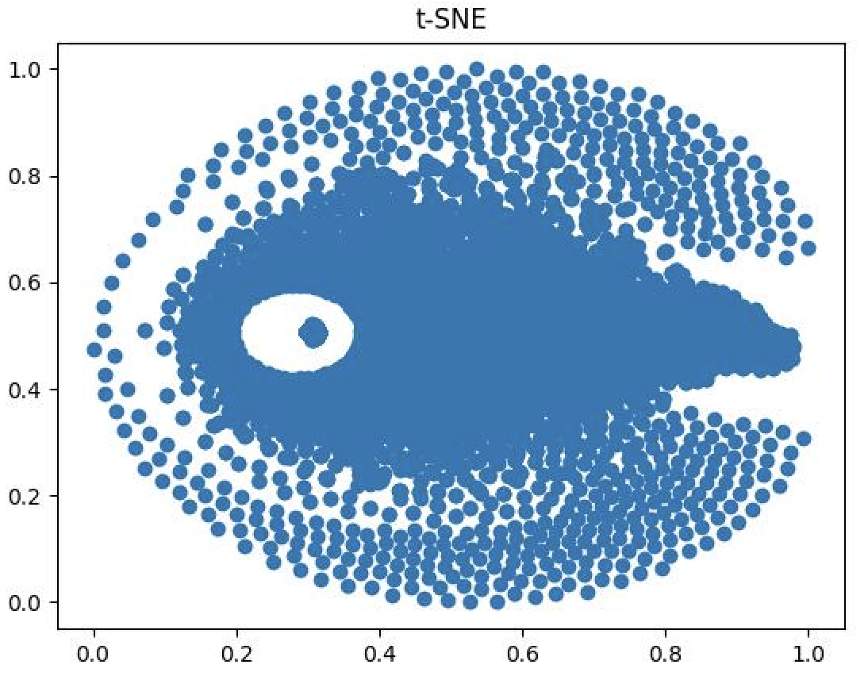
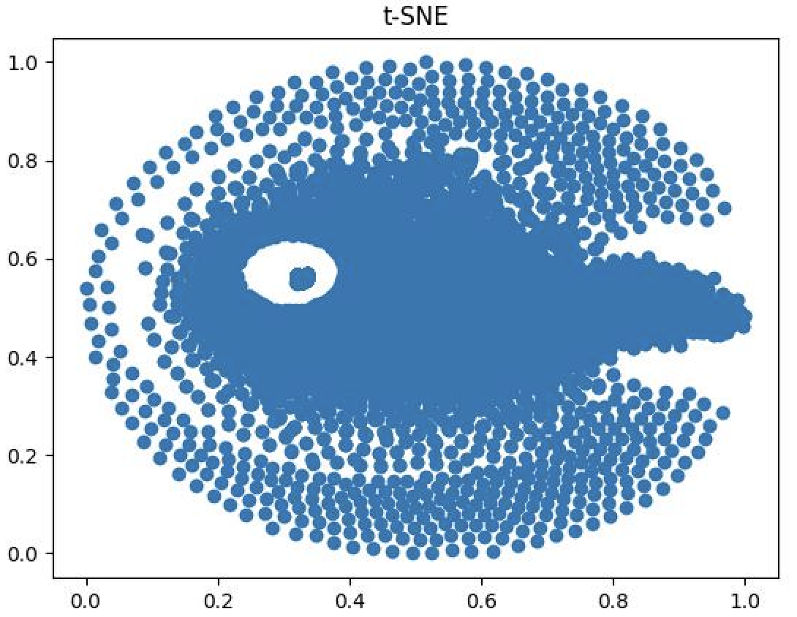
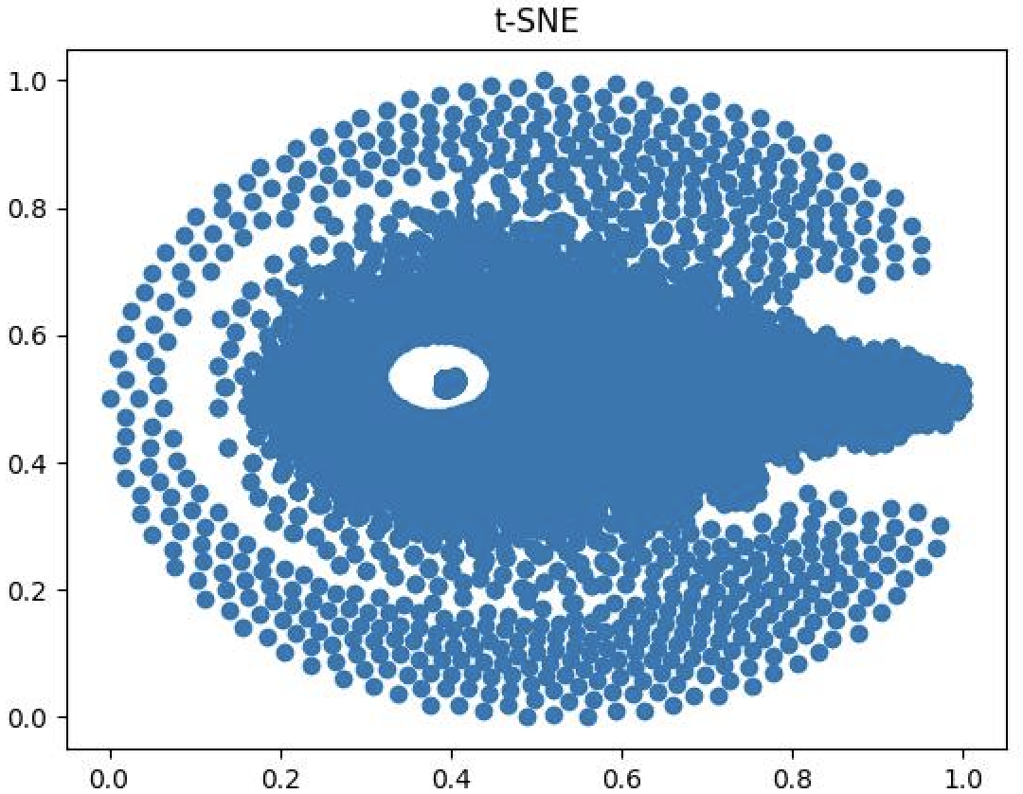
T-SNE visualization of memory vector

Slide 4
Towards Better Evaluation for Dynamic Link Prediction
Datasets
Dataset | Domain | # Nodes | Total Edges
Flights | Transport | 13,169 | 1,927,145
Can. Parl. | Politics | 734 | 74,478
US Legis. | Politics | 225 | 60,396
UN Trade | Economics | 255 | 507,497
UN Vote | Politics | 201 | 1,035,742
Contact | Proximity | 694 | 2,426,280
Dataset | Node | Edge | Edge weights
Flights | Airport | Tracked flight | # flights between two airports in a day
Can. Parl. | MP | Two MPs both voted ‘yes’ | # times that one MP voted ‘yes’ for another MP
US Legis. | Congress person | Two persons have co-sponsored a bill | # times that two persons have co-sponsored a bill
UN Trade | Country | Transactions | # import or export values between two countries
UN Vote | Nation | Two nations both voted ‘yes’ | Increment by one when two nations both voted ‘yes’
Contact | Student | Two students are within close proximity | Physical proximity

Slide 5
Towards Better Evaluation for Dynamic Link Prediction
EdgeBank (baseline)
The memory component of EdgeBank is simply a dictionary which is updated with newly observed edges at each timestamp, similar to the memory update procedure of TGN
At test time, EdgeBank predicts a test edge as positive if the edge was seen before (stored in the memory), and negative otherwise
EdgeBank∞ : 1. stores all observed edges in memory (long-term)
2. prone to false positives on edges which appear once but rarely reoccur over time.
EdgeBanktw : 1. only remembers edges from a fixed size time window (short-term)
2. The size of the time window is set to the duration of validation split

Slide 6
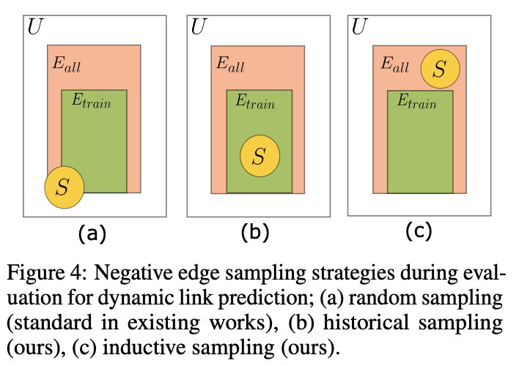
Towards Better Evaluation for Dynamic Link Prediction
Negative Sampling
Historical Negative Sampling: sampling negative edges from the set of edges that have been observed during previous timestamps but are absent in the current step.
For a given time step t, we sample from the edges e ∈ (E_{train} ∩ E_{t}).
Inductive Negative Sampling: sample from the edges e ∈ (E_{test} ∩ E_{train} ∩ E_{t}) at time step t

Slide 7
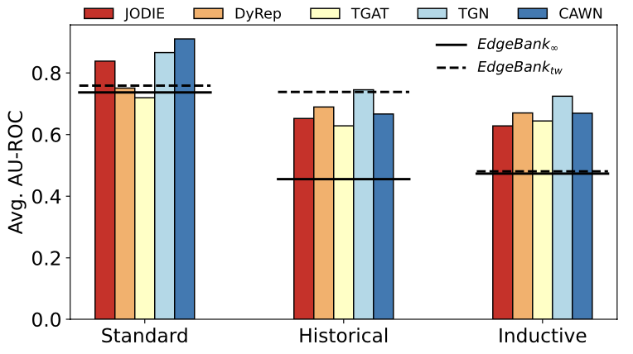
Towards Better Evaluation for Dynamic Link Prediction

